Slide 1


Eni Hal
10/21/21

Slide 2

Outline
Executive Summary
Introduction
Methodology
Results
Conclusion
Appendix

Slide 3

Executive Summary
Summary of methodologies
Data collection – utilizing APIs and web scrapping
Data wrangling – feature engineering and data cleanup
EDA with visualization and SQL
Interactive maps of launch sites
Dashboard reports with interactive graphics
Classification algorithms and prediction
Summary of all results
Conducted extensive EDA with visualizations
Decision tree model ended up providing the best accuracy results, during our predictive modeling phase.

Slide 4


Introduction
Project background and context
SpaceX has the ability to reuse the first stage part of the rocket, which dramatically reduces the cost of space launches. Competitors' space launches cost around $165M, while SpaceX launches are roughly around $62M. Successful return and landing of the first stage part of the rocket is crucial in cost reduction and we want to evaluate what variables are significant in predicting a successful return landing of the first stage.
Investigation topics
Which variables are significant in predicting a successful landing of the first stage
What role does weight, or location play?
Which model is the best predictor?
What is the accuracy of our chosen model?

Slide 5


Slide 6
Methodology – Executive Summary
Data collection methodology:
Data was obtained via API, specifically SpaceX REST API.
Web scrapping
Perform data wrangling
Unnecessary columns were dropped
Null values for Payload field were replaced with mean values
One-hot encoding of categorical columns
Perform exploratory data analysis (EDA) using visualization and SQL
Perform interactive visual analytics using Folium and Plotly Dash
Perform predictive analysis using classification models
Building, tuning, and performance evaluation

Slide 7
Data Collection
The SpaceX data was obtained via an API, specifically the SpaceX REST API.
This API provided data regarding launches, the rocket used, payload delivered, launch specifications, landing specifications, and landing outcome.
Data was obtained in JSON format and then converted to a dataframe in Python
We also had the ability to obtain data via web scrapping, from Wikipedia
SpaceX REST API
Retrieve Launch Data in JSON format
Convert JSON to Dataframe

Slide 8
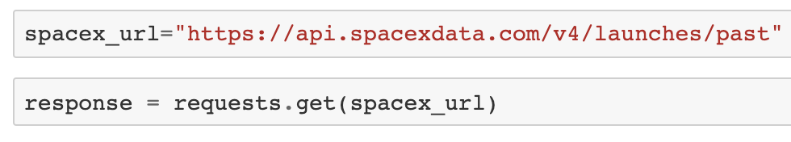
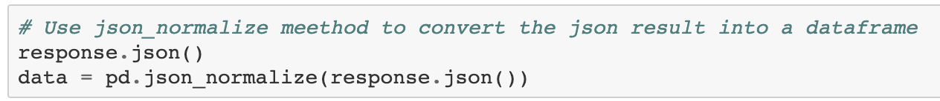
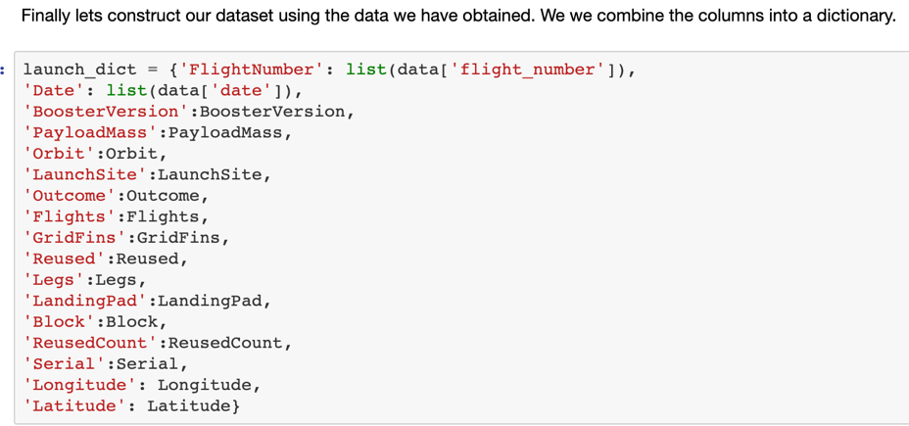
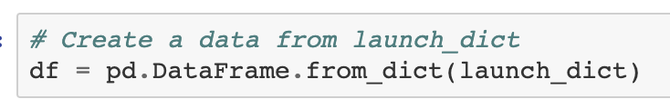
Data Collection – SpaceX API
SpaceX REST API
Retrieve Launch Data in JSON format
Convert JSON to Dataframe
Construct dictionary with all lists
Convert dictionary to final DF
1)
2)
3)
4)
Click HERE for GitHub notebook

Slide 9
Data Collection – Scraping Process Overview
HTML
Get HTML Response from wiki
Beautiful Soup
Extract data via Beautiful Soup
Columns
Dictionary to DF
Convert lists to dictionary
Finally, convert dictionary to DF
Find desired columns, parse data into lists
Click HERE for GitHub notebook

Slide 10
Data Wrangling
Success Indicator
Blank values
Data Types
Evaluated data types
Evaluated blank values to ensure no issues
Analyzed launch outcomes by orbit
Created “Landing_class’’ indicator column to label successful outcome as 1 and unsuccessful outcomes as 0
Click HERE for GitHub notebook

Slide 11
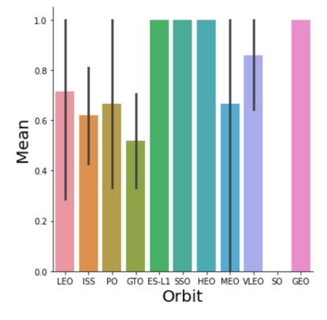
EDA with Data Visualization
In this EDA we’re looking at a number of variables, to determine their impact on a successful return of the first stage.
Pay-load Mass weight
Mean success rate by Orbit
A number of orbits have very high success rates, while others don’t – so we can observe some significant differences
Click HERE for GitHub notebook

Slide 12
EDA with SQL
Below are some of the SQL queries that were performed to analyze the data:
List of distinct launch sites
Launch sites that begin with “KSC”
Total payload mass carried by boosters launched by NASA (CRS)
Average payload mass carried by booster version F9 v1.1
List the date where the successful landing outcome in drone ship was achieved
List the names of the boosters which have success in ground pad and have payload mass greater than 4000 but less than 6000
List the total number of successful and failure mission outcomes
Please see notebook for more info
Click HERE for GitHub notebook

Slide 13
Build an Interactive Map with Folium
Following map objects were created using Folium Map package:
Circles
Lines
Lables
These objects were added to show locations of launch sites, and their distance from certain landmarks – such as coastline
Objects were also added to mark successes and failures of each launch site
Please see notebook for further details
Click HERE for GitHub notebook

Slide 14
Build a Dashboard with Plotly Dash
Following was added to the dashboard:
Drop-down list of launch sites
This drop down will serve as an input into the pie chart, so we display information for the desired selection
Pie-chart of success rate of selected launch sites
This shows the success rates for one ore all launch sites, and it’s interactive
Scroll bar
Allows for scrolling and better viewing
Scatterplot
To see the non-linear pattern of the pay load mass and the various booster versions
Allows us to easily see min/max ranges of the data
Frequencies of launces by booster version and their success rates
Click HERE for GitHub notebook

Slide 15
Predictive Analysis (Classification)
Laid groundwork with data acquisition, feature engineering, EDA
Built and evaluated following categorization models:
Logistic regression
KNN
Decision tree
Modeling Approach and Highlights:
Split data into Train/Test
Evaluated using accuracy measure and by looking at confusion matrix
Optimized accuracy by optimizing parameters using grid search approach
Click HERE for GitHub notebook

Slide 16

Results
Exploratory data analysis results
Interactive analytics demo in screenshots
Predictive analysis results

Slide 17


Slide 18
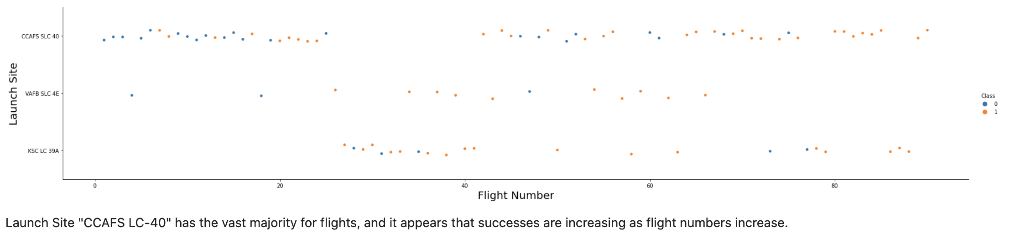
Flight Number vs. Launch Site

Slide 19
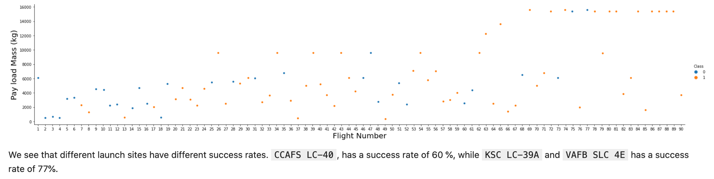
Payload vs. Launch Site

Slide 20
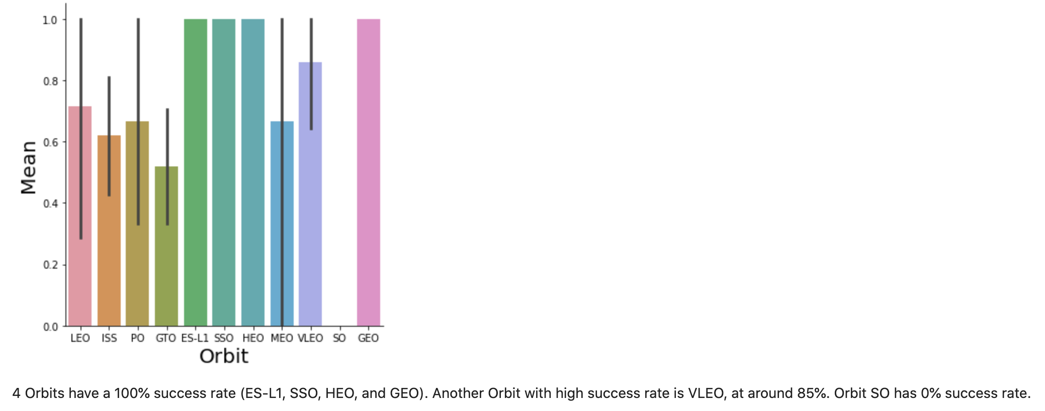
Success Rate vs. Orbit Type

Slide 21
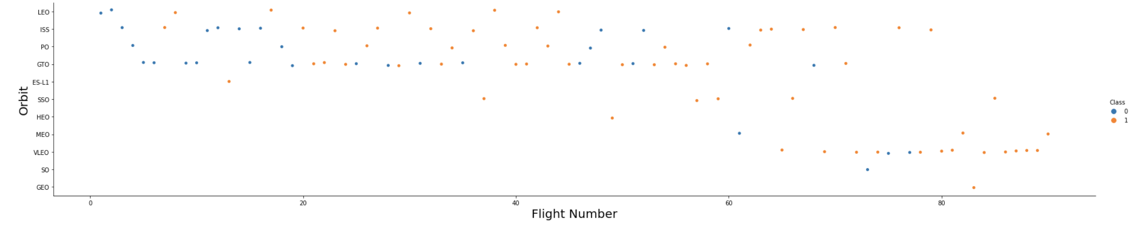
Flight Number vs. Orbit Type

Slide 22
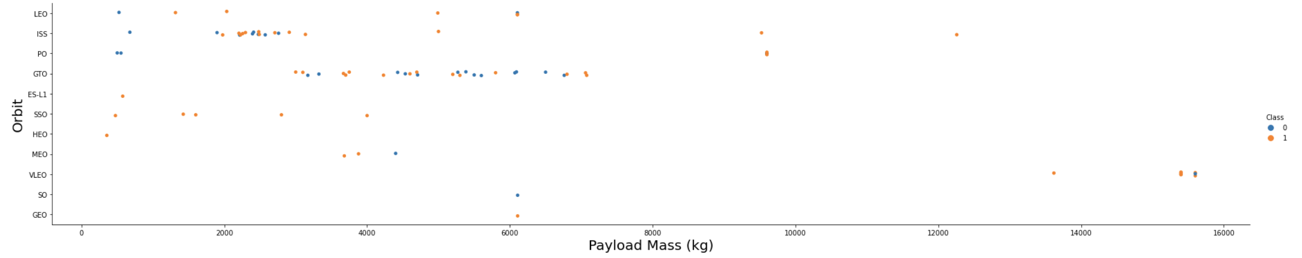
Payload vs. Orbit Type
We observe that Heavy payloads have a negative influence on GTO orbits and positive on GTO and Polar LEO (ISS) orbits.

Slide 23
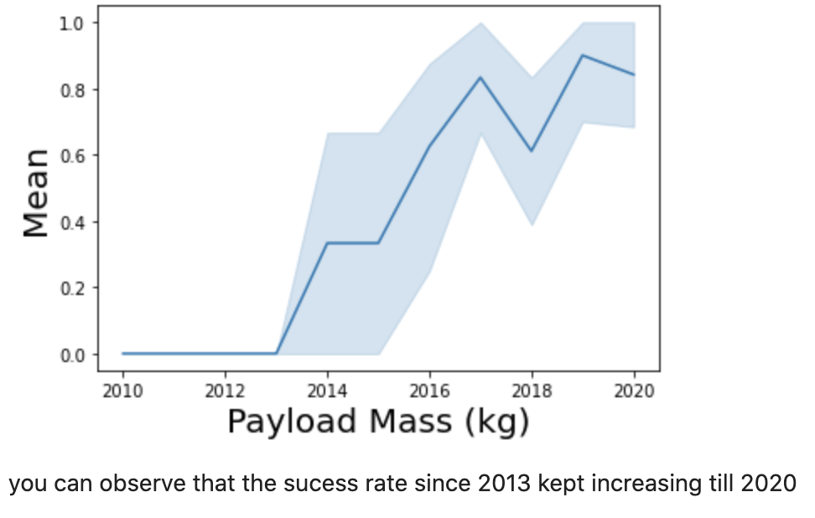
Launch Success Yearly Trend

Slide 24
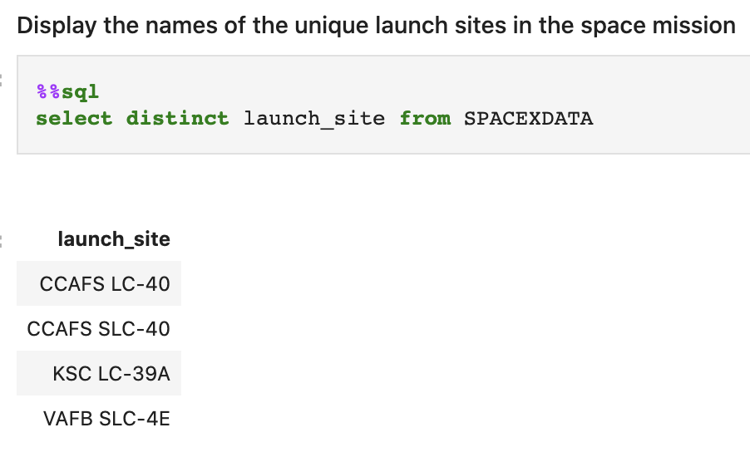
All Launch Site Names
We used SQL distinct clause to obtain a list of all distinct launch sites.

Slide 25
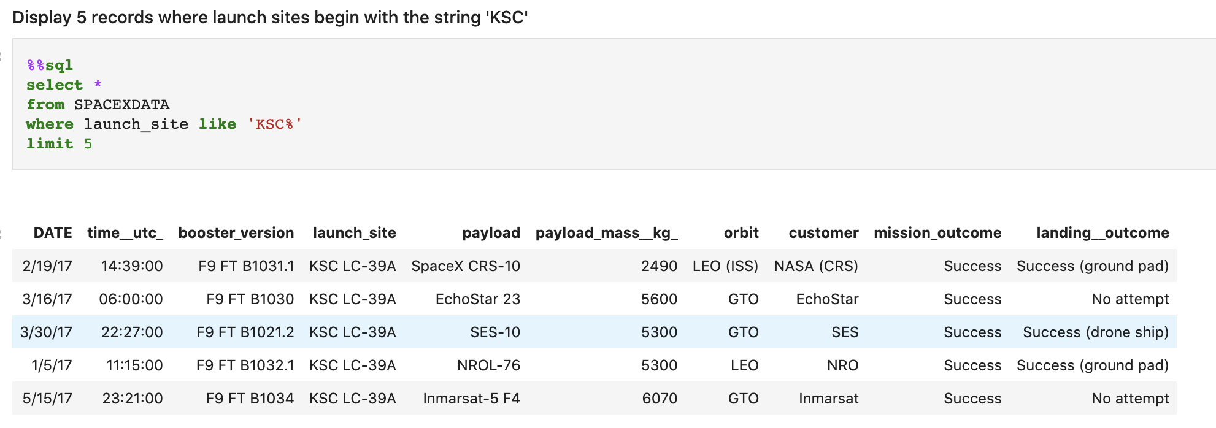
Launch Site Names Begin with ‘KSC'
We used the WHERE clause combined with the LIKE clause to filter launch sites beginning with “KSC”.

Slide 26
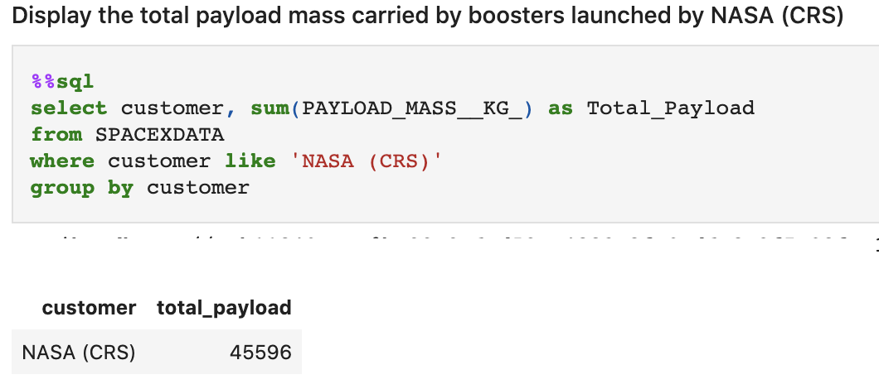
Total Payload Mass

Slide 27
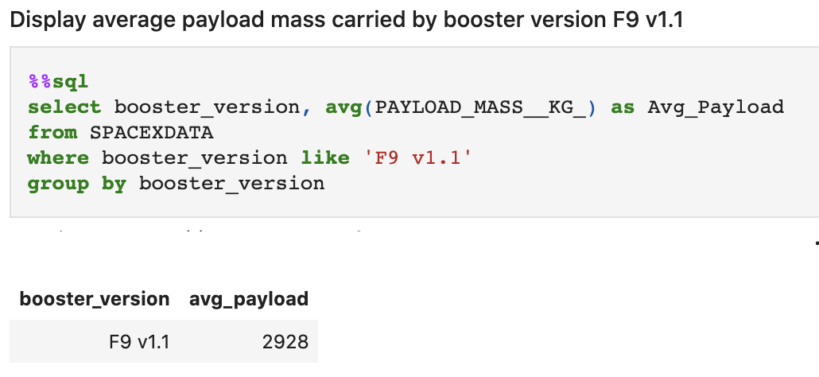
Average Payload Mass by F9 v1.1
We filtered the data by using the WHERE and LIKE clauses. Grouping the data helped aggregate the average payload mass.

Slide 28
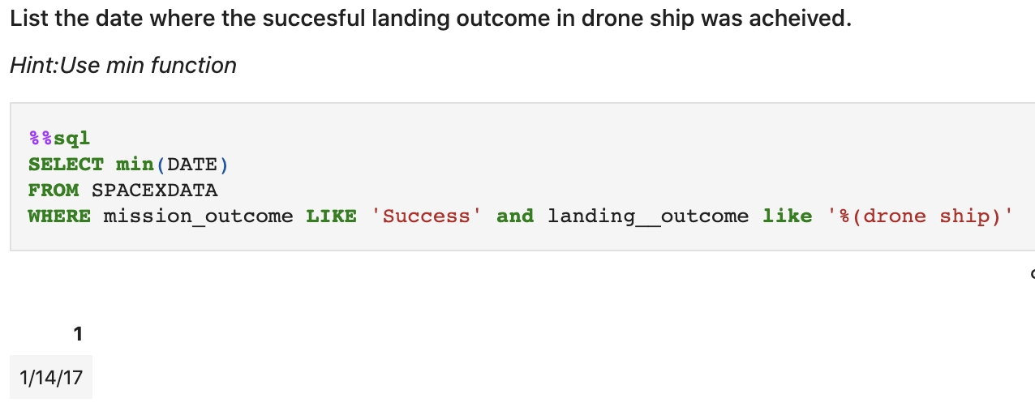
First Successful Ground Landing Date
We used min function to get the earliest date, along with filtering criteria.

Slide 29
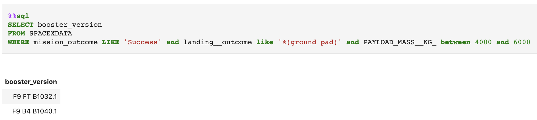
Successful Drone Ship Landing with Payload between 4000 and 6000

Slide 30
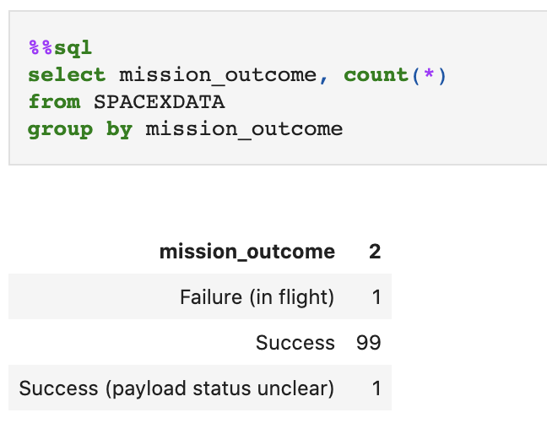
Total Number of Successful and Failure Mission Outcomes
We used count(*) to get the count, along with groupby to get the information.

Slide 31
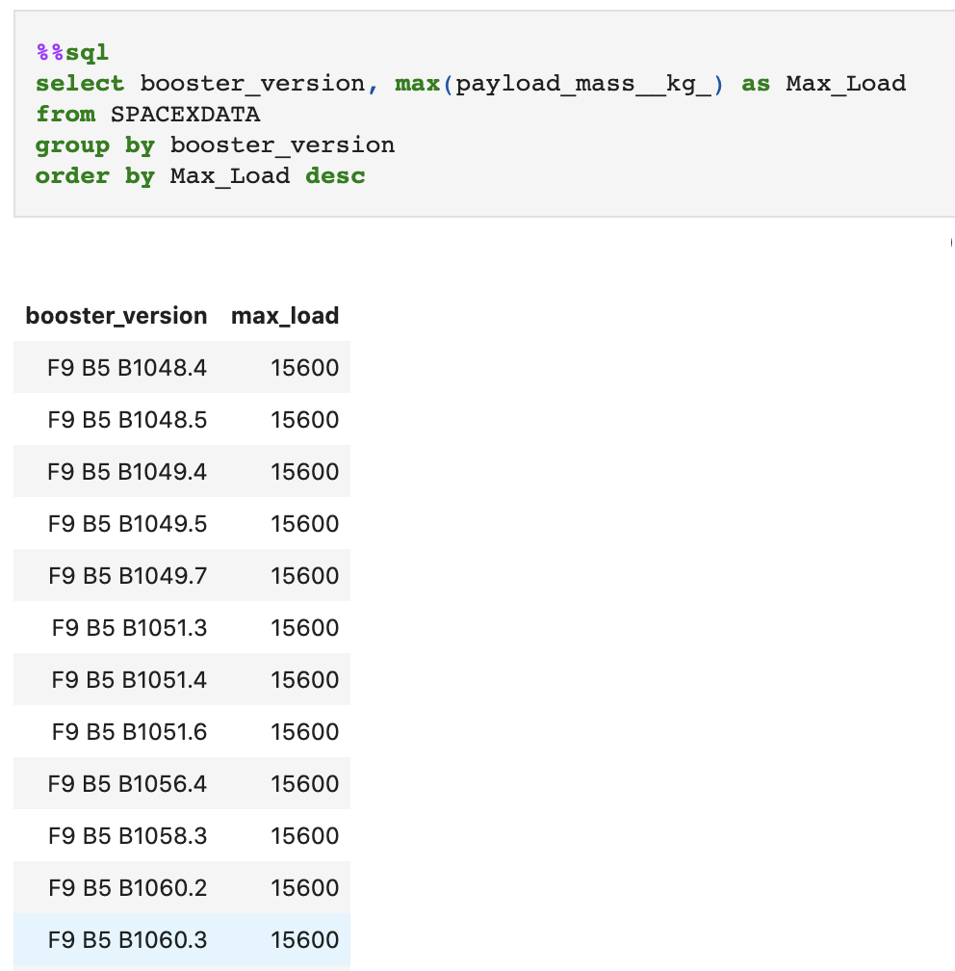
Boosters Carried Maximum Payload

Slide 32
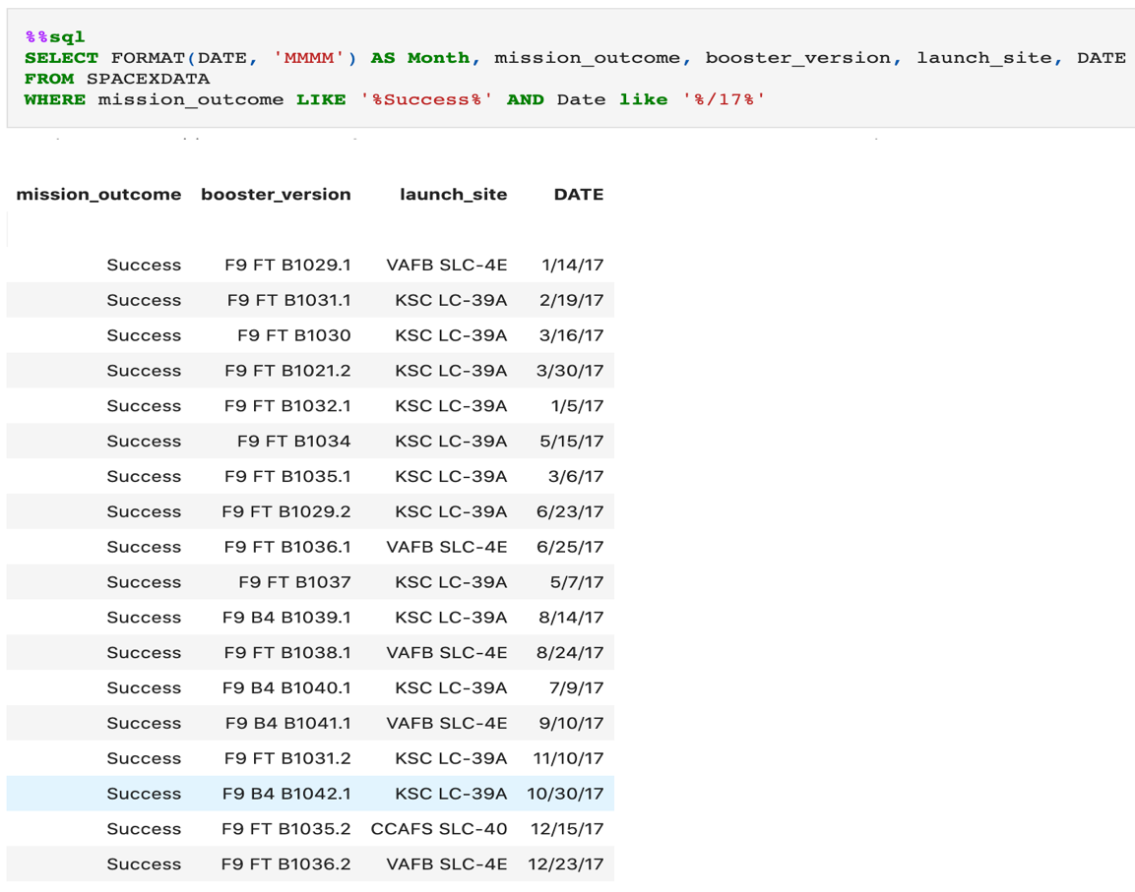
2017 Launch Records

Slide 33
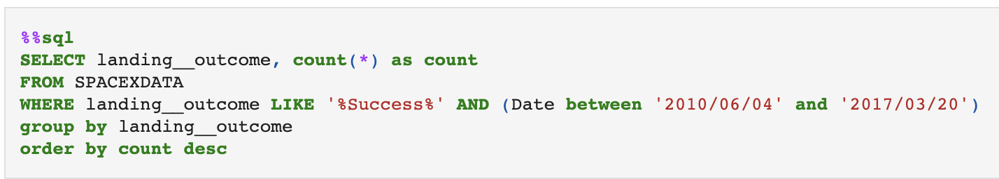
Rank Landing Outcomes Between 2010-06-04 and 2017-03-20
We used count(*) to get the count, along with groupby to get the information by landing_outcome. Order by was utilized to order the results by descending order.

Slide 34


Slide 35
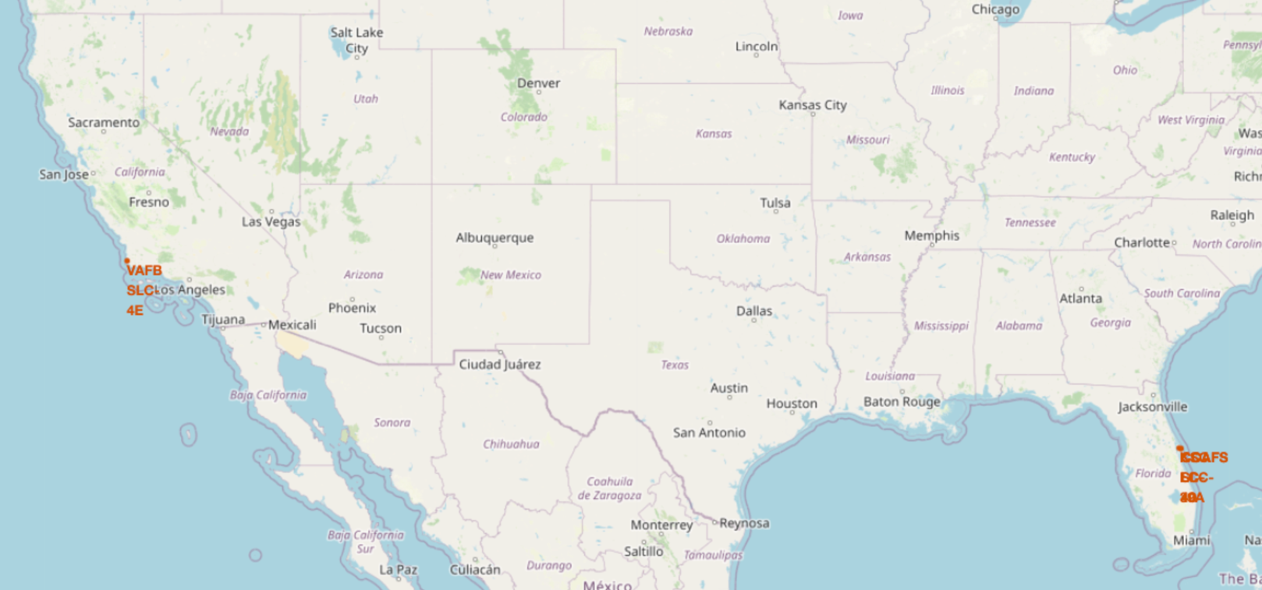
SPACEX Launch Sites in US
In this map we can see markers for launch sites in Florida and Southern California.

Slide 36
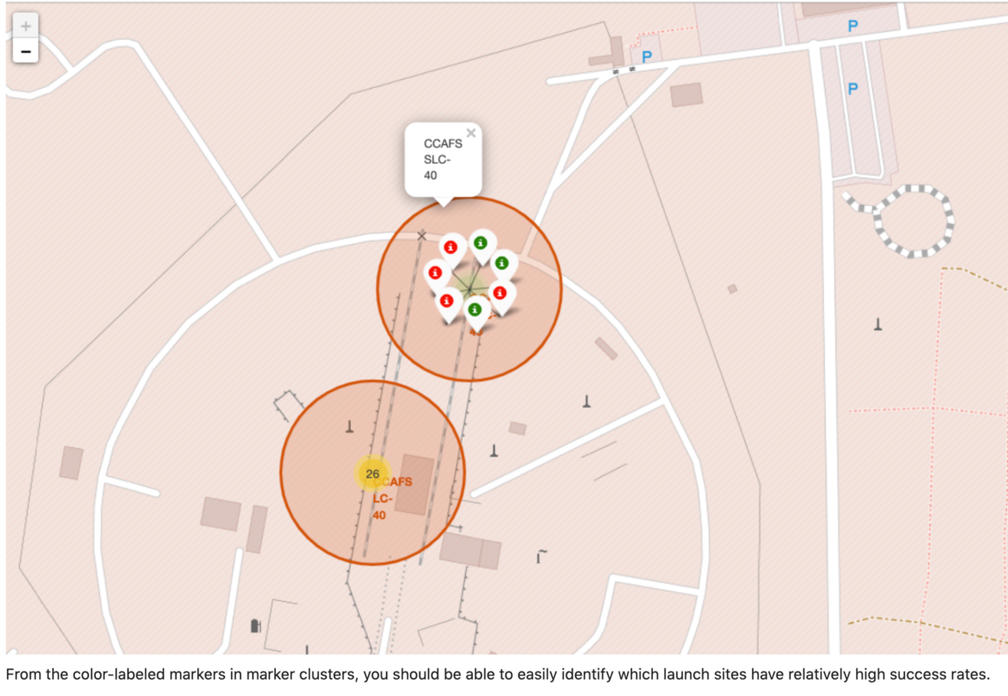
High-Success Rate Launch Site

Slide 37


Slide 38
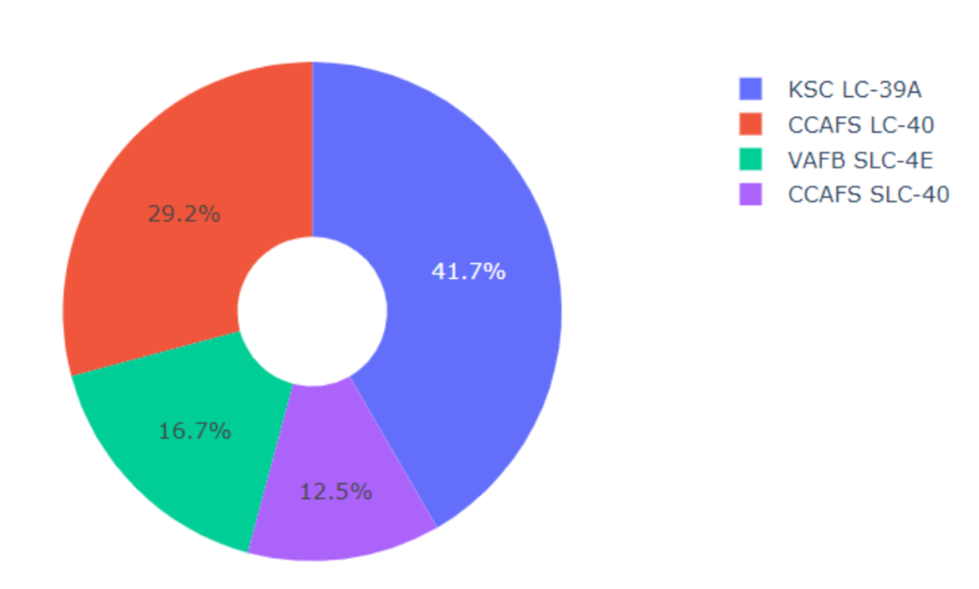
Success Rate by Site
We can observe that launch site KSC LC-39A had the highest portion of sucesses.

Slide 39
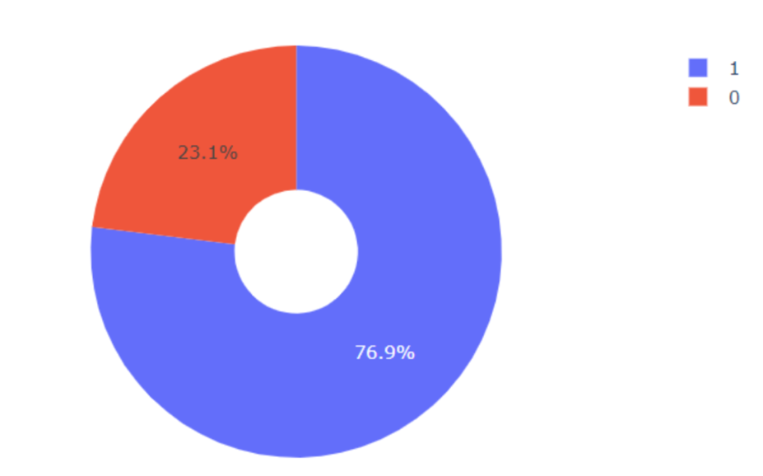
<Dashboard Screenshot 2>
Taking a closer look at site KSC LC-39A, we can see that the overall success rate sits at 76.9% and failure at 23.1%.

Slide 40


Slide 41
Classification Accuracy
All three models performed quite well, however the Decision Tree model did have the best accuracy with over 90% accuracy!

Slide 42
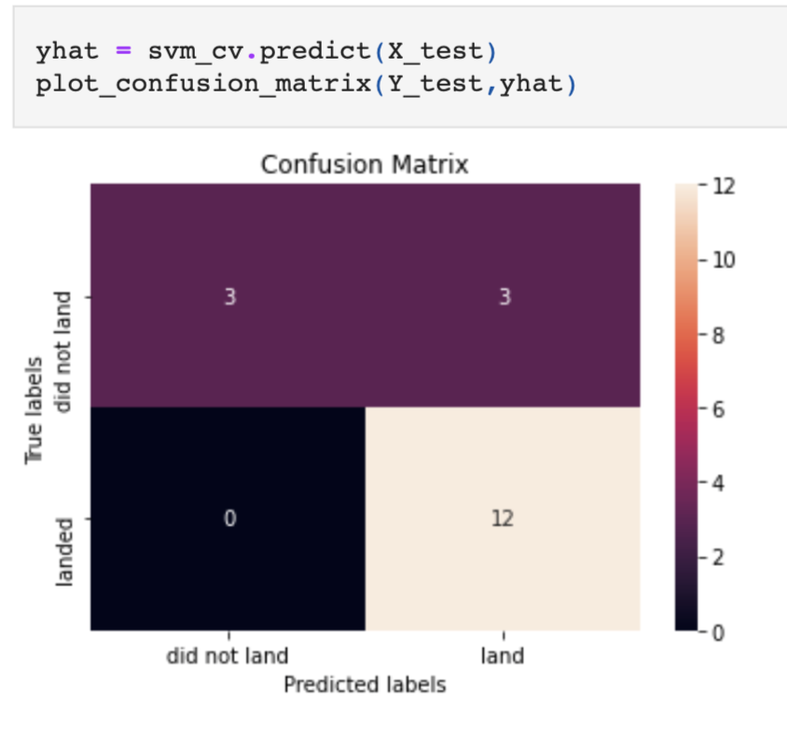
Confusion Matrix
From the confusion matrix we can see that the model performs quite well in predicting true positives. It also predicts 3 true negatives, but struggles a bit with predicting 3 false positives.

Slide 43
Conclusions
We concluded that the decision tree algorithm performed the best, with incredible 93% accuracy. However, we also observed some lack in precision, due to false positives.
We’ve observed a significant increasing trend in successful launches starting from 2013
Launch site KSC LC-39A has the highest success rate, with around 73% successful launches
Payload mass turned out to be also an indicator, and heavier payload mass was associated with more successful launches.

Slide 44


